Slide 1
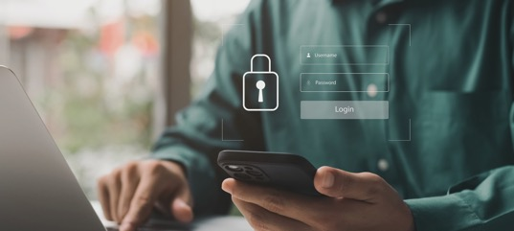


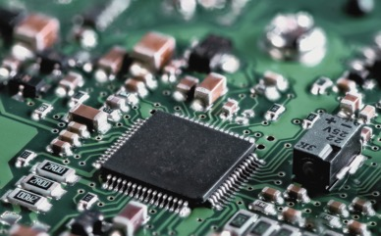
MCPC x KSU Outreach Event
An Overview of MCPC Services and Technology
Prepared for | Kent State University
Presented by | Lorenzo Toscano, ISO Genese Sarratt, Director of Community & Employee Engagement
Date | 4/1/2026

Slide 2

Meeting Goals
Presenters Overview
MCPC Company Overview
Device Lifecycle Services
Technology Review
Recruiting Metrics
Contacts
Agenda
Copyright © MCPC Incorporated. All Rights Reserved.

Slide 3

Meeting Goals
Understand MCPC’s Services and their Purpose
Review of some of MCPC’s Technology
Review of MCPC’s Talent Metrics
MCPC is a global endpoint management company designed to help businesses and organizations improve user productivity, enhance security, mitigate risks, and maximize budgets.
From device lifecycle management to IT talent solutions, MCPC helps you simplify complexity, strengthen security, and empower your workforce — across every stage of technology’s journey.

Slide 4

Introductions
Presenters
Lorenzo Toscano
Information Security Officer
8 years of IT experience | M.L.S. Cybersecurity
5 years at MCPC | B.S. Computer Science
KSU and CSU Alumni | Industry Certifications
Genese Sarratt, CPC
Director of Community & Employee Engagement
7 years of IT experience | 7 years of Technical Recruiting
19 years at MCPC | B.A. Business, Marketing Minor
University of Toledo Alumni | Industry Certifications

Slide 5

INTRODUCTION
Company
Snapshot
Type / Category
# of Unique Certifications
Customer Retention Rate
99%
Managed Service Provider /
IT Services
27
Years of Experience
# of Community Partners
2024 CRN Managed Service Provider 500
Founded in 2002
26+

Slide 6

SUPPLIER OVERVIEW
Strategic Partnerships
Awards
  T-Mobile first and primary partner for their Connected Worker program
  Intel partner of the year
  HP North American Partner of the Year
Lenovo Partner of the Year

Slide 7
In few words:
Customers want to buy devices in bulk, MCPC ensures customers retain the device for long enough to get return on their investment, but not so long that the device becomes obsolete.
Customers buy the device through MCPC, MCPC configures it to specification. (Software installation, peripherals, customer settings…)
MCPC may deliver it directly to customer locations installed at the user’s desk or even sent to the end user’s home address.
Upon device end of life or termination of employment MCPC may retrieve the device and find new life or value in the device.
What does MCPC do?
MCPC whole suit of services is referred “Device Lifecycle Management”

Slide 8
Device Lifecycle Management
disposition
plan
protect
provision
maintain
deploy
Every organization, regardless of industry and size, must manage these areas effectively for optimal device performance.

Slide 9




What technology do we use internally and to support our services?
IT Asset Monitoring
Automated Patching
Remote Desktop
Device Management
EDR/XDR
Antivirus
Identity Management
Ticketing System
Progress Tracking
Secure Erasure
Drive Sanitation
Certificate of Destruction
Windows Server
Business Applications
SIEM/SOAR
Copyright © MCPC Incorporated. All Rights Reserved.
9

Slide 10


Device Lifecycle
Birth
Life
Death
Device is purchased
Device is stored
Device is configured to specifications
Device is shipped to customer
Device is installed in customer’s environment
Device is monitored
Device is updated
Device is protected
Device is tracked
Device could be reclaimed
Device could be repurposed
Device could be repaired
Device is retrieved
Data in the device is erased
Data on the device is destroyed
Device is tracked
Device could be recycled
Device could be repurposed
Device could be repaired
Device could be remarketed

Slide 11
Log Retention and Analysis
Logs have to be retained and analyzed
A SIEM/SOAR solution is required
Retention varies based on segment
The most efficient process to retain logs is through a Single Pane of Glass approach.

Slide 12
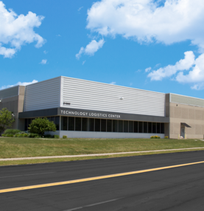
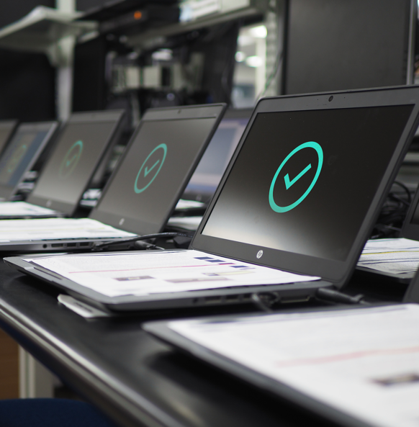
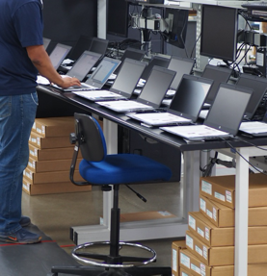
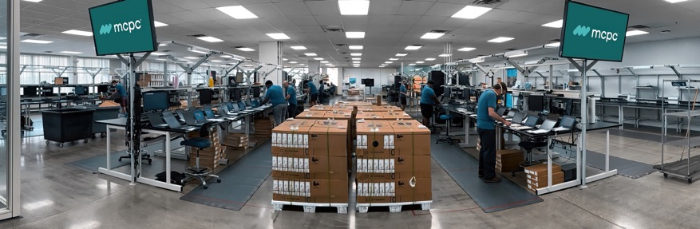
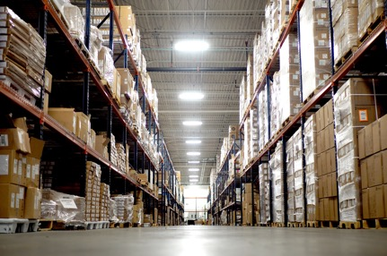
FACILITIES
Technology
Logistics
Centers
Sq Footage
250,000+
Benches
200+
Configuration + Logistics
Devices Annual
  Inventory Management
  Device Imaging
  Staging & Integration
  Cloud Enrollment
  Repair Services
  Supply Chain Logistics
1.2 M

Slide 13
Logistics Center Technology and Security for our Services
Technologies
Data Sanitization
-WDS (Windows Deployment Services)
-MECM/SCCM (Configuration Manager)
-Autopilot (cloud-based device configuration)
-Intune (Modern Management)
-EntraID (Identity Provider)
-PowerBI (Reporting)
-PfSense/OPNsense (S2S VPN)
-SQL (Database)
-Apple Business Manager (Apple Device Management)
-Cisco Meraki (networking)
-Lenel (Physical Access Control)
-Microsoft Azure (SaaS, IaaS, PaaS)
-exacqVision (Cameras)
-Cato Networks (S2S + S2U VPN)
-Microsoft Office
-Blancco (Similar to DBAN)
Security Frameworks
-NAID AAA
-SOC2

Slide 14
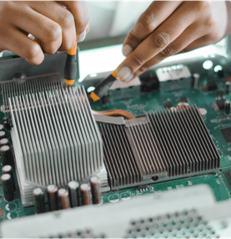
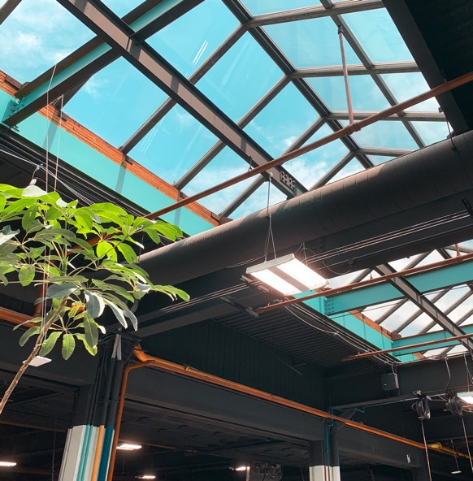
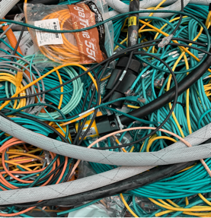


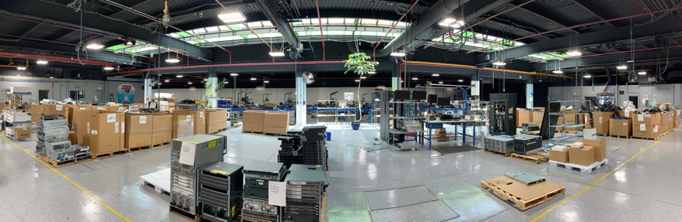
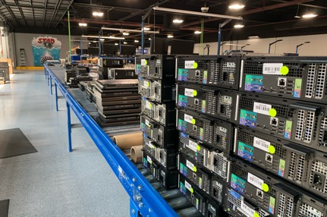
FACILITIES
Technology
Disposition
Centers
Sq Footage
100,000
Yearly Sorted Devices
1M pounds
Recycling + Data Destruction
Certified
  Recycling
  Remarketing
  Data Destruction
  Asset Intelligence
  Compliance

Slide 15
Logistics Center Technology and Security for our Services
Technologies
Data Sanitization
-BlueIQ (Data Disposition ERP)
-Autopilot (cloud-based device configuration)
-Intune (Modern Management)
-Green Sight Technologies (Device Value)
-PowerBI (Reporting)
-BitSight (drive erasure verification)
-SQL (Database)
-Apple Business Manager (AppleOS Management)
-Cisco Meraki (networking)
-Lenel (Physical Access Control)
-exacqVision (Cameras)
-Cato Networks (S2S + S2U VPN)
-Blancco (Similar to DBAN)
Security and Compliance Frameworks
-NAID AAA
-SOC2
-DoD 5220.22-M
-NIST 800-88
-ISO 9001
-ISO 14001
-e-Stewards

Slide 16
Artificial Intelligence
It would not be a 2026 presentation without mentioning AI
There are differences between consumer grade AI and enterprise AI.
Contractual agreements are starting to include Gen-AI provisions.
How does an organization support this?
Organizations usually pick one AI of choice
Train users on why we should only use this AI
Block all other Gen-AI
Problem: If there is a will there is a way, power users will still use non-authorized AI. Small, inexpensive experimental AI environments still need to be maintained for few individuals.
AI Security and Business issues:
Calculating ROI for AI usage is really hard.
Does AI make employees more efficient? Does the quality of the work improve?
AI comes with no warranties. While it offers impressive code generation capabilities (vibe coding), additional time is often spent testing, commenting, and standardizing that code.
AI evolves faster than we can keep up with it, tools used today are often surpassed on the next release cycle. Making it hard to pick single tools.
Finally, AI is inherently unsafe, agents and algorithms can be jailbroken through prompt injection, and the security community just started to catch up to it (CrowdStrike AIDR)

Slide 17
Ideal Candidates for MCPC
Attribute | Description | Why It Matters
Technical Proficiency | Solid foundation in relevant tools, systems, & technologies | Ensures candidates can contribute effectively from day one
Curiosity | Desire to learn, ask questions, & explore new ideas | Drives innovations and continuous improvement
Problem-Solving | Ability to analyze issues & identify root causes | Leads to reliable, long-term solutions
Communication | Clear verbal & written explanation of technical concepts | Great communicators reduce conflict, improves collaboration, speeds up problem solving
Teamwork | Ability to collaborate & share knowledge | Supports efficient, high-performing teams
Accountability | Ownership of tasks, deadlines, & outcomes | Supports growth & development, builds trust, and drives better performance
Security Mindset | Awareness of cybersecurity risks & best practices | Protects systems, data, & business continuity
*Attitude - essential in a candidate because it shapes how you show up to work, shows that you are coachable and adaptable, and it improves the workplace culture

Slide 18
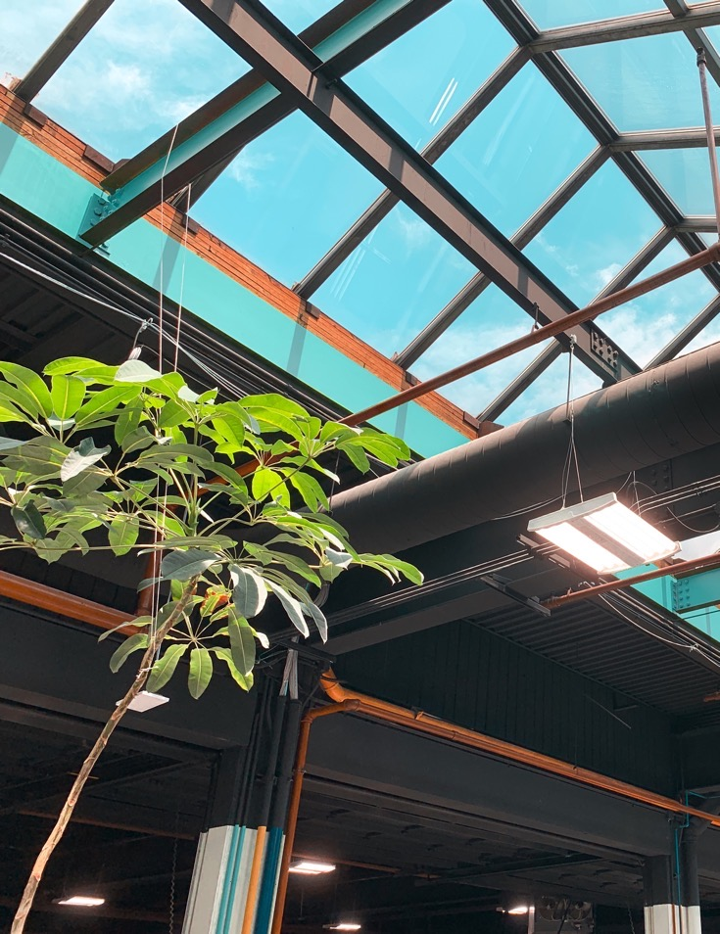
Questions?
For additional information, please contact:
Lorenzo Toscano
Information Security Officer
ltoscano@mcpc.com
Genese Sarratt
Director of Community & Employee Engagement
gsarratt@mcpc.com
MCPC, Inc.
888.777.7178 | www.MCPC.com
Copyright © MCPC Incorporated. All Rights Reserved.

